Slide 1
CMSD Overview of Student Growth Measures and 2018-19 SLO Writing

Slide 2
Objectives
By the end of the presentation, you should be able to do the following:
Explain the different types of Student Growth Measures and how SGM teacher categories are determined
Determine your teachers’ (likely) SGM category and assessments for the 2018-19 school year
Explain the changes for 2018-19
Support your staff in the SLO Writing Process

Slide 3
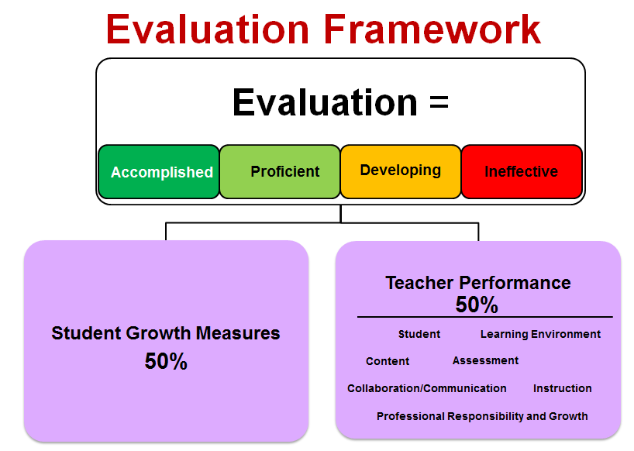
How do SLOs Fit into the Ohio Teacher Evaluation System?

Slide 4
CMSD teachers receive at least 2 different measures
Types of Measures
Value Added
Vendor Assessments
Student Learning Objectives (SLOs)

Slide 5
ODE Defined Teacher Categories
Category | Teachers are in this category if…
A1 | They receive value-added reports using state assessments for all courses they teach.
A2 | They receive value-added scores using state assessments for some, but not all, courses.
B | They do not receive any value-added reports based on state assessments but they use vendor assessments that produce growth scores.
C | They do not receive any value-added reports or vendor assessment growth scores.

Slide 6
Category A

Slide 7
About Value Added…
ODE calculates a VA score for each teacher whose students take OST state tests (in the prior year).
OSTs taken in 2017-18 and 2016-17 will be used to determine VA for 2018-19.
Value Added scores transfer from one district to another.
Teacher reports will be in EVAAS

Slide 8
Category B

Slide 9
About Vendor Assessments
ODE has an Approved Vendor Assessments list for SGM
Vendor Assessments that CMSD uses are: STAR, CAP, Aimsweb, Pro-Core, and WebXam
Each vendor calculates Teacher Effectiveness Ratings using their statistical methodology approved by the state (based on each teacher’s student data). Teacher receives a score of 1,2,3,4 or 5 from the vendor.
Teachers must administer the required pre- and post-assessments in the Fall and in the Spring.

Slide 10
Category C

Slide 11
Student Learning Objectives (SLOs)
CMSD teachers write 2 SLOs
Appendix D is CMSD’s Common Assessment Map to let teachers know which Category they fall in and which assessments they should write their SLOs on.
Teachers must write SLOs only on the assessments as identified in Appendix D.
For more information on what SLOs are, review the SLO Handbook and the SLO Checklist in SchoolNet.

Slide 12
Review Appendix D

Slide 13
What’s New for the 2018-19 SY
Changes to SLO Assessments
(Appendix D Changes)
SAT replaces ACT
HS Intervention Teachers
AimswebPlus -- SGM will be calculated using additional measures for K-3
No 2nd SLO for K teachers

Slide 14
Do I have to do SLOs?
ALL teachers should use Appendix D as a guide to determine their category and assessments for their student growth measures.
ALL teachers should answer the questions in the SLO portal.
If you are not sure of your SGM, email the SLO Mailbox. Don’t assume.
SLO Portal questions will help guide you, but verify using Appendix D.

Slide 15
What about Intervention Specialists?
Are regular teachers
Must access & answer questions in the portal
Must write SLOs – unless you ONLY teach K-3 or HS students who do not take regular assessments. (Must still access the portal.)
If an IS does not have scheduled courses in eSchoolPlus, must create custom courses for SLOs AND Vendor Assessments.

Slide 16
What about Intervention Specialists?
Must combine classes if you do not have “enough” students. Otherwise they will be combined for you.
Alternately assessed students should not be assessed using both the pre and post regular assessments.

Slide 17
Other SLO Reminders
TARGET ADJUSTMENTS:
Review the guidelines for target adjustments.
Targets are set based on historical performance of CMSD students, and reflect typical/reasonable growth, not aggressive growth
Special Education is not a reason for lowering targets
Attendance is not a reason for lowering targets
Teacher Absence is not a reason for lowering targets
INCLUDED STUDENTS:
All students in a class should be included on a teacher’s roster. The only reasons to remove a student are:
if the teacher no longer teaches the student OR
if there is no pre-test score for a student.

Slide 18
The SGM Portal – Tips
http://esupport/sgm (Internet Explorer only)
Principal Set up is Important!!
If teachers’ courses are incorrect, teachers must create their own Custom Courses, submit them, and get them approved before they can complete SLOs.
Auto-Submit is still an option for those not submitting target adjustments.
Type in PORTAL RESET in subject of email if this is all the teacher needs

Slide 19
SLO Writing Timeline
Sept 24 & 25 – SLO Training
Sept 25-Oct 10 – Principal Portal Setup
Oct 11 – SGM Portal Opens
Oct 17, 3-5pm – Drop In Session
Oct 26 – Portal Closes for Submissions of initial SLOs
Nov 9 – Portal Closes for Final Approvals

Slide 20
(New) Teacher Journey You’ve given the pre-test. Now What?
Collect Data (SchoolNet or other sources)
Review where you fall on Appendix D
Review portal directions, and go into the portal. -- Do you have the MySGM tab? If not, ask principal to add you to the team. If yes, answer the portal questions.
Write your SLOs (Use handbook and other resources)
Submit SLOs by 10/26. The earlier, the better.
If Approved, you’re done. If not, revise and resubmit until they are approved. (Check your email!!!)

Slide 21
TDES Team Responsibilities
Train teachers on the SLO writing process
Maintain copies of Appendix D and Review where each of your teachers falls on Appendix D
Provide guidance and information to all teachers. Pay special attention to new teachers.
Review submitted SLOs and make recommendations

Slide 22
Principal Responsibilities
Before the SLO Writing Process…
Keep eSchool Schedules up to date
Set up your School Staff & TDES Team in the Portal
During the SLO Writing Process…
Approve (Decline) all custom courses submitted by teachers
Approve (Decline) all SLOs submitted by teachers
In the Winter and Spring…
Approve (Decline) SLO Roster Verifications submitted by teachers
Approve (Decline) Vendor Roster Verifications submitted by teachers

Slide 23
Feedback
What issues did you have last year that new people should know about?
Write down 2 issues you had to help your teachers with in the past. This will help us with struggling school.

Slide 24
Questions?
SGM Resources are/will be available in SchoolNet:
https://cleveland.schoolnet.com/outreach/csd/slo/
Email questions about SGM or SLOs to the SLO Mailbox:
SLO@clevelandmetroschools.org

Slide 25
Thank you for your time!
Mark Baumgartner, Director of Professional Issues, CTU
Deb Paden, Member-at-Large: Senior/Special Educational Issues Chairperson, CTU
Julie Snipes-Rea, CMSD Organizational Accountability
Karen Thompson, CMSD Chief of Staff

